Slide 1


Variables

Slide 2

New Prizes

Slide 3
Class Rhythm
Morning Lecture
Lab 1
Section
Lunch
Afternoon Lecture
Lab 2
Break
Lab 3

Slide 4
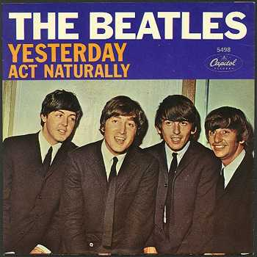
Review

Slide 5
Control Statements
for(int i = 0; i < N; i++) {
// to repeat N times
}
while(condition) {
// repeat while condition holds
}
if(condition) {
// todo if true
} else {
// todo if false
}
Notes:
Ask them what they think the difference is between the two types of loops

Slide 6
Review From Yesterday
MountainKarel
Climb Up Mountain
Step Up
Pick Beeper
Climb Down Mountain
Step Down
Notes:
He looks like an old machintosh machine.
Hes got legs… one sticks out the back. That’s just the way it is.

Slide 7
Brackets and Indentation
public void run() {
while (beepersInBag()) {
findTree();
addLeavesToTree();
}
moveToWall();
}
private void addLeavesToTree() {
turnLeft();
climbTree();
addLeaves();
descendToGround();
turnLeft();
private void findTree() {
moveToWall();
}
Notes:
He looks like an old machintosh machine.
Hes got legs… one sticks out the back. That’s just the way it is.

Slide 8
Brackets and Indentation
public void run() {
while (beepersInBag()) {
findTree();
addLeavesToTree();
}
moveToWall();
}
private void addLeavesToTree() {
turnLeft();
climbTree();
addLeaves();
descendToGround();
turnLeft();
private void findTree() {
moveToWall();
}
Notes:
He looks like an old machintosh machine.
Hes got legs… one sticks out the back. That’s just the way it is.

Slide 9
Brackets and Indentation
public void run() {
while (beepersInBag()) {
findTree();
addLeavesToTree();
}
moveToWall();
}
private void addLeavesToTree() {
turnLeft();
climbTree();
addLeaves();
descendToGround();
turnLeft();
}
private void findTree() {
moveToWall();
}
Notes:
He looks like an old machintosh machine.
Hes got legs… one sticks out the back. That’s just the way it is.

Slide 10
Brackets and Indentation
public void run() {
while (beepersInBag()) {
findTree();
addLeavesToTree();
}
moveToWall();
}
private void addLeavesToTree() {
turnLeft();
climbTree();
addLeaves();
descendToGround();
turnLeft();
}
private void findTree() {
moveToWall();
}
Notes:
He looks like an old machintosh machine.
Hes got legs… one sticks out the back. That’s just the way it is.

Slide 11
Brackets and Indentation
public void run() {
while (beepersInBag()) {
findTree();
addLeavesToTree();
}
moveToWall();
}
private void addLeavesToTree() {
turnLeft();
climbTree();
addLeaves();
descendToGround();
turnLeft();
}
private void findTree() {
moveToWall();
}
Notes:
He looks like an old machintosh machine.
Hes got legs… one sticks out the back. That’s just the way it is.

Slide 12
Brackets and Indentation
public void run() {
while (beepersInBag()) {
findTree();
addLeavesToTree();
}
moveToWall();
}
private void addLeavesToTree() {
turnLeft();
climbTree();
addLeaves();
descendToGround();
turnLeft();
}
private void findTree() {
moveToWall();
}
Notes:
He looks like an old machintosh machine.
Hes got legs… one sticks out the back. That’s just the way it is.

Slide 13
Brackets and Indentation
public void run() {
while (beepersInBag()) {
findTree();
addLeavesToTree();
}
moveToWall();
}
private void addLeavesToTree() {
turnLeft();
climbTree();
addLeaves();
descendToGround();
turnLeft();
}
private void findTree() {
moveToWall();
}
Notes:
He looks like an old machintosh machine.
Hes got legs… one sticks out the back. That’s just the way it is.

Slide 14
Brackets and Indentation
public void run() {
while (beepersInBag()) {
findTree();
addLeavesToTree();
}
moveToWall();
}
private void addLeavesToTree() {
turnLeft();
climbTree();
addLeaves();
descendToGround();
turnLeft();
}
private void findTree() {
moveToWall();
}
Notes:
He looks like an old machintosh machine.
Hes got legs… one sticks out the back. That’s just the way it is.

Slide 15
Brackets and Indentation
public void run() {
while (beepersInBag()) {
findTree();
addLeavesToTree();
}
moveToWall();
}
private void addLeavesToTree() {
turnLeft();
climbTree();
addLeaves();
descendToGround();
turnLeft();
}
private void findTree() {
moveToWall();
}
Notes:
He looks like an old machintosh machine.
Hes got legs… one sticks out the back. That’s just the way it is.

Slide 16

See You Later!
I will miss you.
Enjoy Java!
Call me maybe?
Notes:
He looks like an old machintosh machine.
Hes got legs… one sticks out the back. That’s just the way it is.

Slide 17

Java

Slide 18

Hello World
import acm.program.*;
public class HelloProgram extends ConsoleProgram {
public void run() {
println("hello, world");
}
}
import acm.program.*;
public class HelloProgram extends ConsoleProgram {
public void run() {
println("hello, world");
}
}
HelloConsole
hello, world

Slide 19


In Pop Culture

Slide 20
Variables

Slide 21
What is a variable?

Slide 22
[suspense]

Slide 23
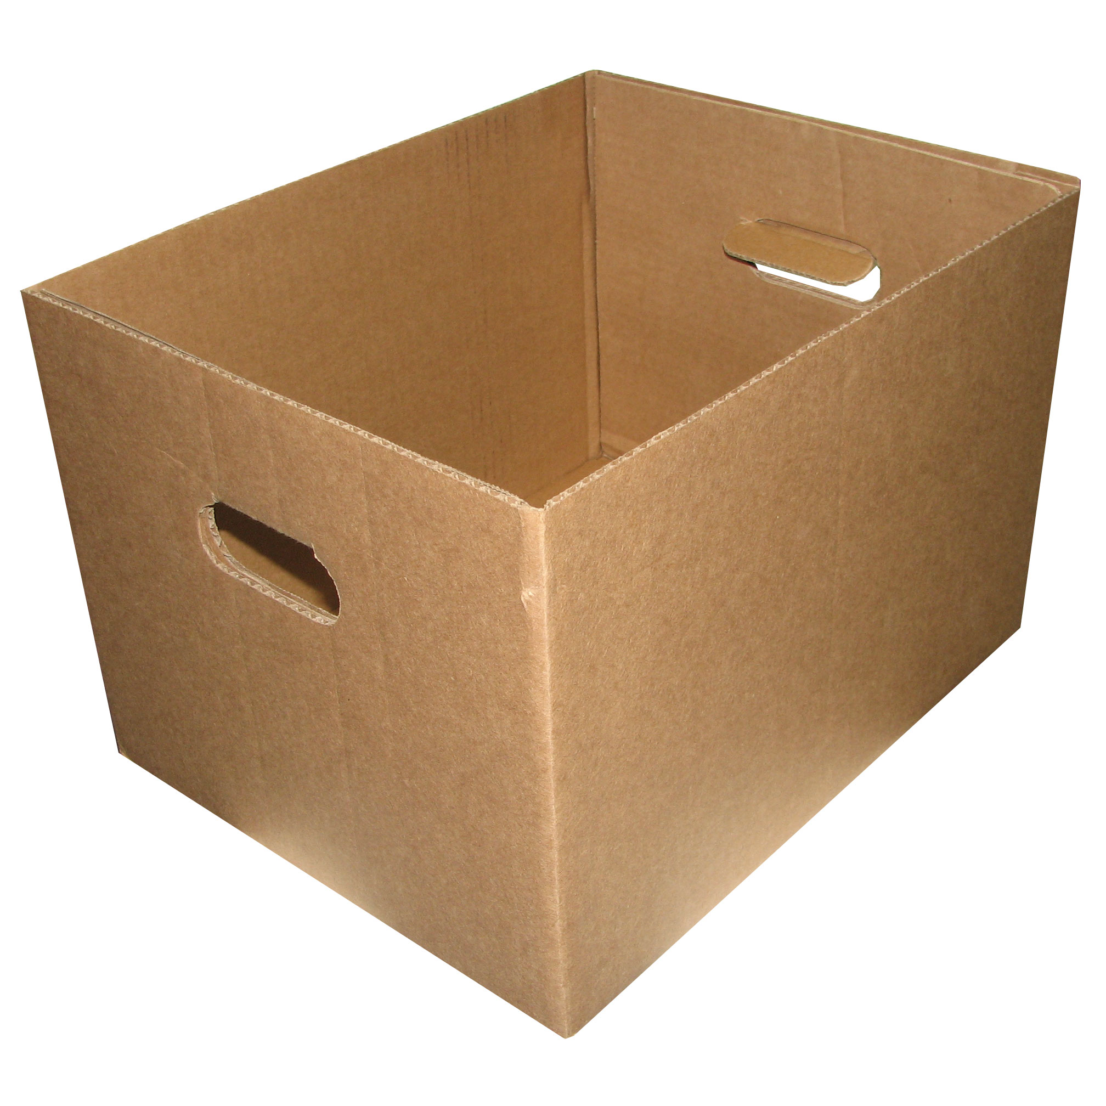
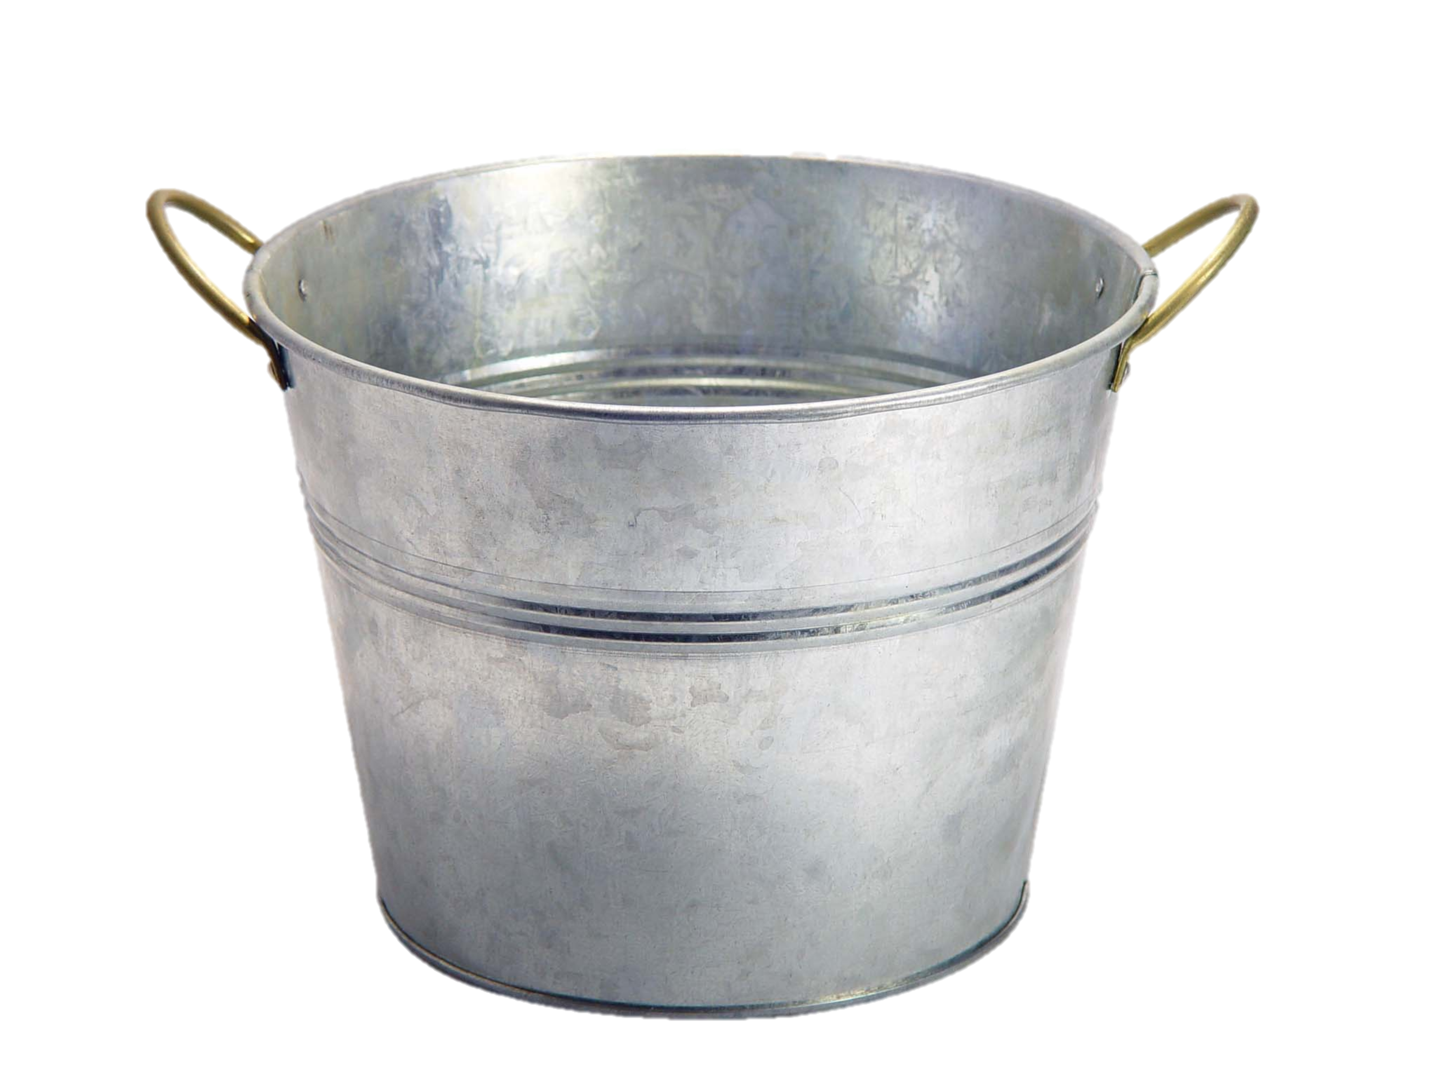
Variables are Like Boxes

Slide 24
Variables are Like Boxes
int total = 42;
name
type
total
42
(contains an int)
value
Notes:
Type name = value

Slide 25
Types
String str = “Hi”;
int num = 5;
double fraction = 0.2

Slide 26
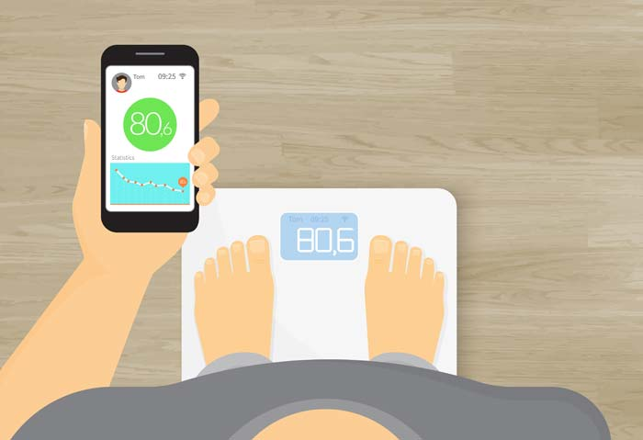
How Much Do I Weigh?

Slide 27
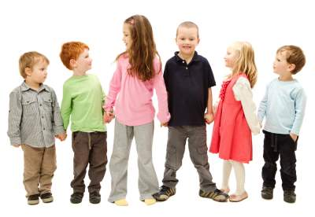
How Many Children Do I Have?

Slide 28
Binary Operators
+
Addition
*
Multiplication
–
Subtraction
/
Division
%
Remainder

Slide 29
Conditions
<
Less Than
==
Equal To
>
Greater Than
>=
More or Equal
<=
Less or Equal

Slide 30
User Input
int a = readInt(“msg”);
double b = readDouble(“msg”);

Slide 31
Example
public void run() {
int userNum = readInt(“?: ”);
if(userNum > 100) {
userNum = 42;
}
int square = userNum * userNum;
println(“Num is: ” + userNum);
println(“Square is: “ + square);
}

Slide 32
Example
public void run() {
int userNum = readInt(“?: ”);
if(userNum > 100) {
userNum = 42;
}
int square = userNum * userNum;
println(“Num is: ” + userNum);
println(“Square is: “ + square);
}
userNum
102

Slide 33
Example
public void run() {
int userNum = readInt(“?: ”);
if(userNum > 100) {
userNum = 42;
}
int square = userNum * userNum;
println(“Num is: ” + userNum);
println(“Square is: “ + square);
}
userNum
102

Slide 34
Example
public void run() {
int userNum = readInt(“?: ”);
if(userNum > 100) {
userNum = 42;
}
int square = userNum * userNum;
println(“Num is: ” + userNum);
println(“Square is: “ + square);
}
userNum
102

Slide 35
Example
public void run() {
int userNum = readInt(“?: ”);
if(userNum > 100) {
userNum = 42;
}
int square = userNum * userNum;
println(“Num is: ” + userNum);
println(“Square is: “ + square);
}
userNum
42

Slide 36
Example
public void run() {
int userNum = readInt(“?: ”);
if(userNum > 100) {
userNum = 42;
}
int square = userNum * userNum;
println(“Num is: ” + userNum);
println(“Square is: “ + square);
}
userNum
42

Slide 37
Example
public void run() {
int userNum = readInt(“?: ”);
if(userNum > 100) {
userNum = 42;
}
int square = userNum * userNum;
println(“Num is: ” + userNum);
println(“Square is: “ + square);
}
userNum
square
42
1764

Slide 38
Example
public void run() {
int userNum = readInt(“?: ”);
if(userNum > 100) {
userNum = 42;
}
int square = userNum * userNum;
println(“Num is: ” + userNum);
println(“Square is: “ + square);
}
userNum
square
42
1764

Slide 39
Example
public void run() {
int userNum = readInt(“?: ”);
if(userNum > 100) {
userNum = 42;
}
int square = userNum * userNum;
println(“Num is: ” + userNum);
println(“Square is: “ + square);
}
userNum
square
42
1764

Slide 40
What do you think this does?
println(1 / 2);

Slide 41
AHHHHHHH!!!!!!
println(1 / 2);

Slide 42
Resulting Type
int + int = Int
double + double = double
int + double = double

Slide 43

Pitfalls of Integer Division
Convert 100˚ Celsius temperature to its Fahrenheit equivalent:
double c = 100;
double f = 9 / 5 * c + 32;
The computation consists of evaluating the following expression:
9 / 5 * c + 32
The problem arises from the fact that both 9 and 5 are of type int, which means that the result is also an int.
132
100
1
9 / 5 * c + 32

Slide 44
Pitfalls of Integer Division
You can fix this problem by converting the fraction to a double, either by inserting decimal points or by using a type cast:
double c = 100;
double f = 9.0 / 5 * c + 32;
The computation now looks like this:
212.0
180.0
1.8
9.0
/ 5 * c + 32

Slide 45
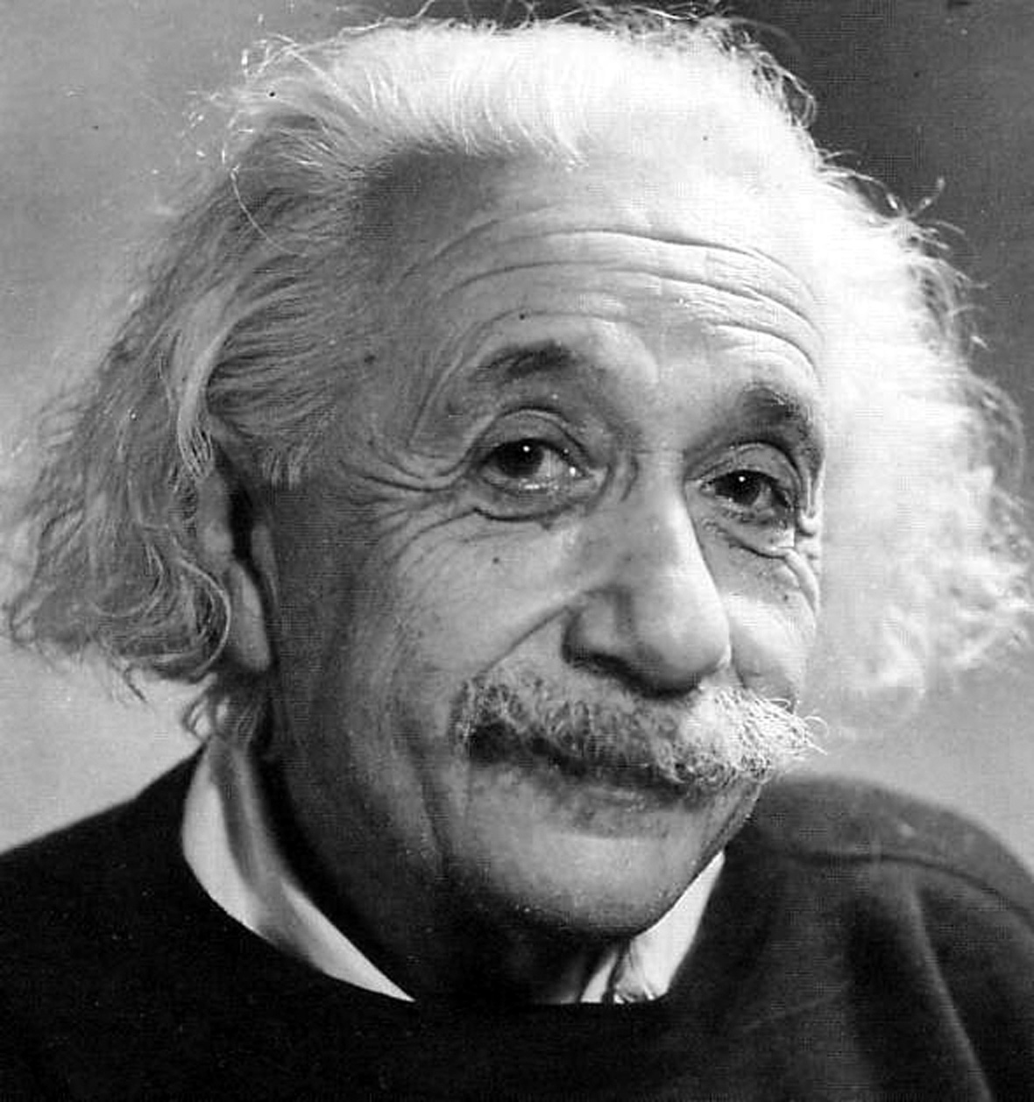

Slide 46
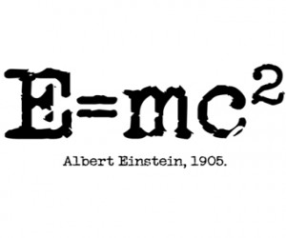

Slide 47
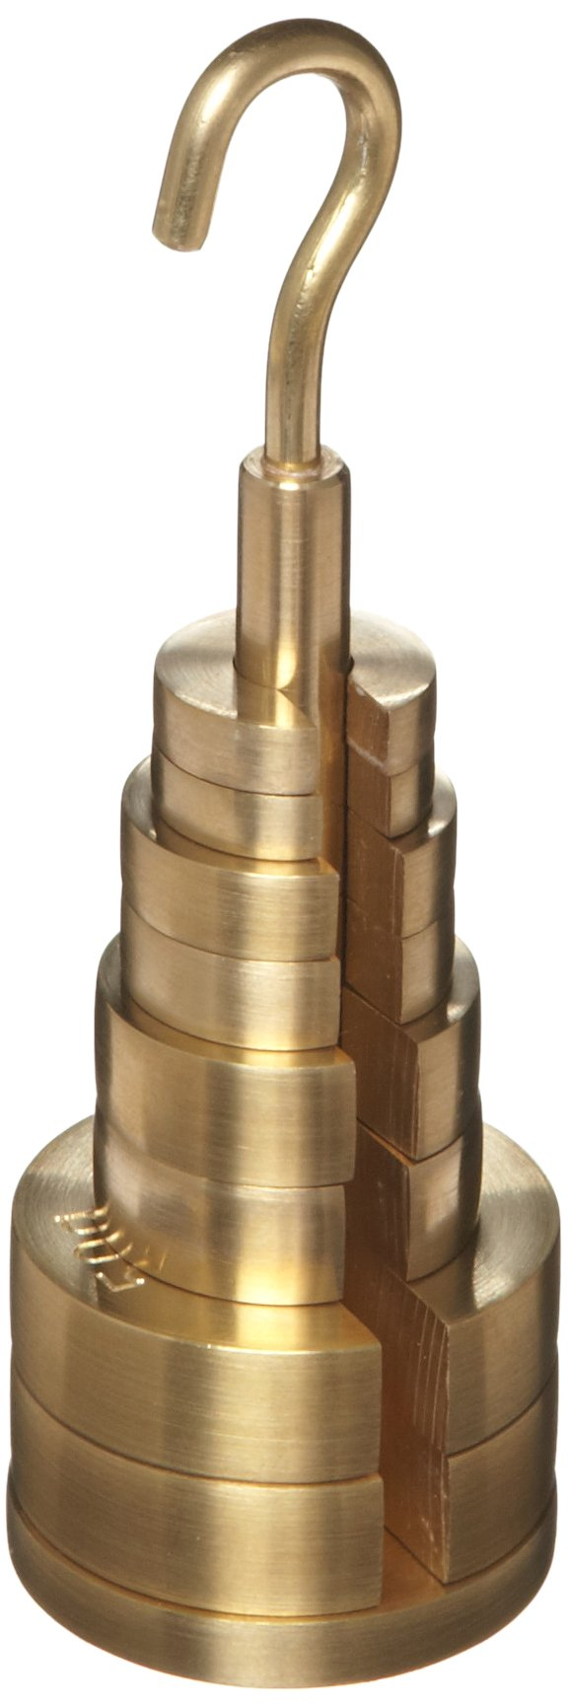

Mass Can Be Turned into Energy

Slide 48
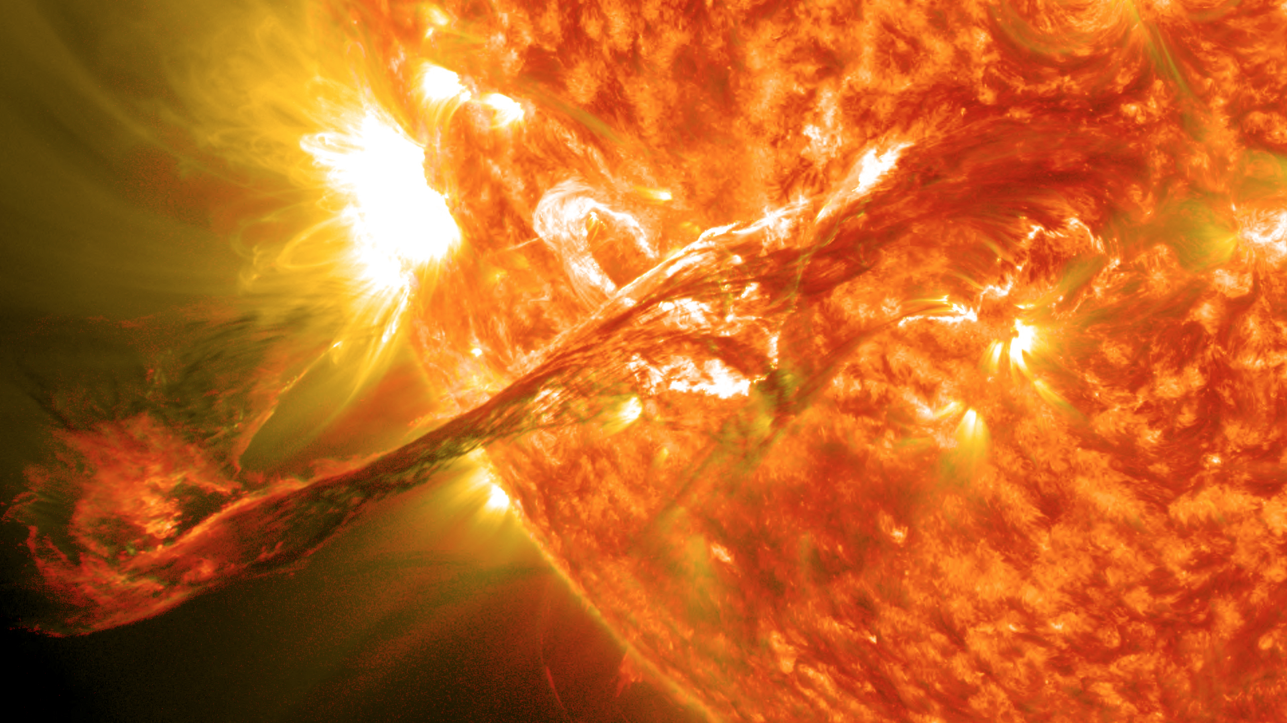

Slide 49
C = 299,792,458 m/s

Slide 50
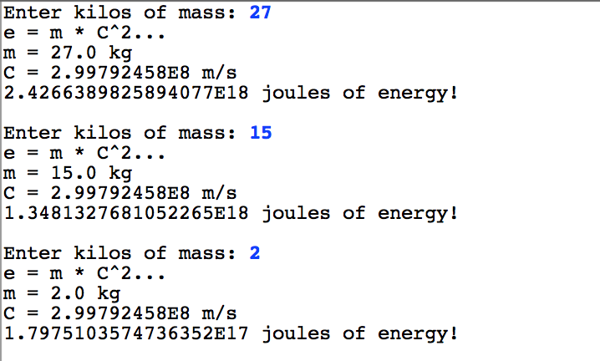
Mass Can Be Turned into Energy

Slide 51

Sandcastles

Slide 52
The End.

Slide 53

The End?

